Slide 1

Comp 20 Web Programming
NODE.JS

Slide 2
Node.js – what is it?
Free open source server environment
Built to serve client requests
Underlying language is JavaScript
Asynchronous!
Typically, a Node.JS file will consist of tasks that are executed when a port on a server is accessed.

Slide 3
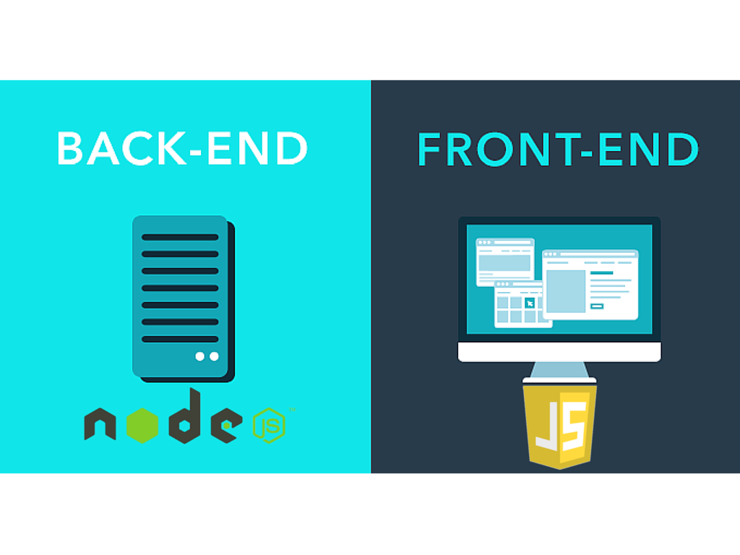
Use node.js to …
Process form data
Handle client requests
Interact with a database
Interact with files on the server

Slide 4
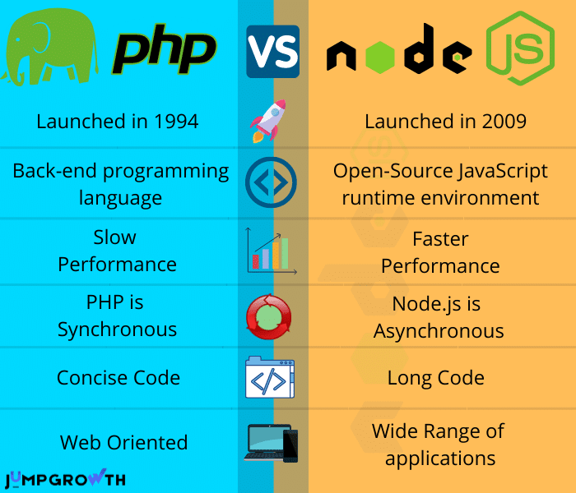
Node.js is asynchronous
PHP handles one request at a time
Node.JS can handle multiple requests
Node.JS is
Fast
Memory efficient
It’s not a competition! PHP and Node.js each have different strengths.

Slide 5
Node.js overview
Think of Node as a runtime engine to deploy server-side code
Node.JS runs a script as a single thread but creates an environment with the benefits of a multi-threaded system by using callback functions
This is especially significant when there is a resource that you may need to wait on (such as an API or a database)

Slide 6
Running Node.js
Run locally or deploy online via Git/Heroku
Download at nodejs.org
Run at the command line or load a .js file
Node.js Modules allow for extended functionality
Use npm (Node Package Manager) to manage/install modules
The local Node environment is known as REPL : Read-Evaluate-Print-Loop
Useful for checking Node.js code

Slide 7
Installing node.js locally
Download
Download Node.js and npm (node package manager) installer
https://nodejs.org/
Open
Open a “command” window
Run
Use the command “node” to enter the node command interface
Use version: node-v14.16.1

Slide 8
Minimal Hello World
Other things to try:
.help
.load
.exit
Use TAB key to see possible JavaScript commands
Open a command window
Type “node” to get into the Node.JS environment
Enter the command: console.log(‘Hello World”);

Slide 9
Creating a “mini” JS script
Multiple lines of code are allowed
Create a variable and its value will persist
Code blocks can be utilized with { }
Multiple lines are allowed
… indicates that you are “in” the code block
for(x = 1; x<=3; x++)
... console.log("hello");
hello
hello
hello

Slide 10
Try it
Open a command line prompt and start the node terminal
Try the following:
Display “Hi there” using console.log
Create a variable “x” and set it to 30, then display x
Create a loop to display 10 asterisks on the screen, one per line
Create a loop to display 10 asterisks on the screen, all on one line

Slide 11
using node.js server
var http = require('http');
http.createServer(function (req, res) {
res.writeHead(200, {'Content-Type': 'text/html'});
res.write('Hello World!’);
res.end();
}).listen(8080);
In this case, activate the server by going to the URL: http://localhost:8080/
Try it: Place the code into a file called hello.js and use .load to run via an external file

Slide 12
Breaking down hello.js
var http = require('http’);
http is a pre-installed module
There are a wealth of existing modules you can access
You can also create your own
Example: install the email module
npm install nodemailer

Slide 13
The http module
The HTTP module creates a server and then returns a response when the server is accessed
.createServer
Creates the server on the specified port
http.createServer(function (req, res) { //code for response goes here
}).listen(8080);
req is request object coming into the server
res is the response object going out to the client

Slide 14
Responding to the client
//Write the HTTP headers
res.writeHead(200, {'Content-Type': 'text/html’});
res.write('Hello Strange World!’); //Write to the page
res.end(); //Done creating page

Slide 15
Try it
Modify hello.js to display your name and the town you currently live in when the web server event is triggered
Open a command window and navigate to the relevant folder
Run it: “node tryit.js”
Ctrl+C to stop

Slide 16
Node.js modules
There are three types of modules – based on their location
Core Modules
Local Modules
Third Party Modules

Slide 17
Core Modules
To use a core module, you only need to require it because it is already installed
var m = require('the_module');
Common core modules
http creates Node.js http server.
url parses a url
querystring parses a query string
path deal with file paths
fs file I/O
util useful functions

Slide 18
Handling an http request example: Multi-page website
var http = require('http');
http.createServer(function (req, res) {
res.writeHead(200, {'Content-Type':'text/html'});
if (req.url == "/")
res.write("This is the home page");
else if (req.url == "/about")
res.write ("This is the about page");
else
res.write ("Unknown page request");
res.end();
}).listen(8080);

Slide 19
Getting post or get data sent from the client
For GET data use the URL module
Gets the query string out of the url
var url = require('url’);
.parse() parses a url into parts
.host protocol and server name/domain
.pathname path within the url
.search query string (including ‘?’)
.query returns query string as an object
For POST data, use the querystring module

Slide 20
Example: get the query string as an object
var http = require('http');
var adr = require('url');
http.createServer(function (req, res) {
res.writeHead(200, {'Content-Type': 'text/html'});
var qobj = adr.parse(req.url, true).query;
res.end(qobj);
}).listen(8080);

Slide 21
Example: Get a value from the query string
var http = require('http');
var url = require('url');
http.createServer(function (req, res) {
res.writeHead(200, {'Content-Type': 'text/html'});
var qobj = url.parse(req.url, true).query;
var txt = qobj.x; // assume x is querystring parameter
res.end(txt);
}).listen(8080);

Slide 22
Query string demo
Create a node.js file to read a query string parameter called id
Display the id on the page

Slide 23
Working with files using the fs module
var http = require('http');
var fs = require('fs');
http.createServer(function (req, res) {
file="hello.html";
fs.readFile(file, function(err, txt) {
res.writeHead(200, {'Content-Type': 'text/html'});
res.write(txt);
res.end();
});
}).listen(8080);

Slide 24
Putting it together
Create a node.js page as follows:
The “home” page will display a form with method=‘post’ that asks for the user’s name
The form action should be set to your node.js server /process
Read the name from the post data and display on the page

Slide 25
the readline module
The readline module reads individual lines from a file.
var readline = require('readline');
var fs = require('fs’);
var myFile = readline.createInterface({
input: fs.createReadStream('test.txt')
});
myFile.on('line', function (line) {
console.log('"' + line + '" has ' + line.length + ' characters');
});

Slide 26
Installing a 3rd party module using npm
NPM (Node Package Manager) installs, updates or uninstalls Node.js packages to give you access to 3rd party modules
The basic format is:
npm install <module name>
Use -g to install the module/package globally on that computer
Use --save to add the module to the dependency list for this “package”
Also available is npm update and npm uninstall

Slide 27
Example: calendar module
The calendar module has functionality to display a calendar
> npm install calendar
c = require("calendar");
cal = new c.Calendar();
m = cal.monthDates(2021,3, function(d) {return (' '+d.getDate()).slice(-2)},
function(w) {return w.join(' | ')});
console.log ("Calendar for April, 2021");
for (i=0; i<m.length; i++)
console.log(m[i]);

Slide 28
Use the calendar module to write to the web page
c = require("calendar");
var http = require('http');
cal = new c.Calendar();
m = cal.monthDates(2020,11, function(d) {return (' '+d.getDate()).slice(-2)},
function(w) {
s = "";
for (j=0; j<w.length; j++)
s += "<div class='col'>" + w[j] + "</div>";
return s;
}
);

Slide 29
Example continued
http.createServer(function (req, res) {
res.writeHead(200, {'Content-Type': 'text/html'});
res.write ("<html><head><style type='text/css'>.col {display: inline-block; width:40px; border: 1px solid #333;} </style></head>");
res.write("<body>My Calendar<br />");
for (i=0; i<m.length; i++)
res.write(m[i] + "<br />")
res.end("</body></html>");
}).listen(8080);

Slide 30

Local modules: Grow your own
Example: create a module to get the date/time
exports.getDate = function () {
return Date();
};

Slide 31
Add the module to your script
require the module in the script
var dt = require('./datemodule.js’);
Use the module in the event function
res.write("Current date/time: " + dt.getDate());

Slide 32
A module can be an object
exports.myobj = {
a: 1,
b : function() { return 10;}
};

Slide 33
var http = require('http');
var obj = require('./myobj.js');
http.createServer(function (req, res) {
res.writeHead(200, {'Content-Type': 'text/html'});
res.write("a is " + obj.myobj.a + "<br>");
res.write("b is " + obj.myobj.b() + "<br>");
res.end();
}).listen(8080);

Slide 34
Try it
Create a module to return the price of an item. Possible items are hotdogs ($3.50), fries ($2.00) and soda ($1.50)
You will need to create an object in the module to store the names/prices of the items.
Create a .js file to load the module and read the value of a query string parameter called “item” from the query string and then display the price of that item

Slide 35
Connecting node.js to MongoDB
The Mongo module
npm install mongodb
var mongo = require('mongodb’);
MongoClient
Class that encapsulates connection to a MongoDB database
var MongoClient = mongo.MongoClient;
MongoClient.connect(url, callback)
Can connect to database on localhost or via atlas
“url” parameter is the connection string

Slide 36
Connecting to mongo
MongoClient.connect(url, { useUnifiedTopology: true }, function(err, db) {
if(err) { console.log("Connection err: " + err); return; }
var dbo = db.db("Textbooks");
var collection = dbo.collection('books’);
…
});

Slide 37
Insert data
Use insertOne to add one new document
Use insertMany (with an array) to insert a group of documents
var newData = {"title": "Who Ate the Cheese", "author": "Fin Haddie"};
collection.insertOne(newData, function(err, res) {
if (err) throw err;
console.log("new document inserted");
} );

Slide 38
Delete data
Use deleteOne or deleteMany
Be careful to test your condition clause first!
var theQuery = { title: /^Who/ };
collection.deleteMany(theQuery, function(err, obj) {
if (err) throw err;
console.log("document(s) deleted");
});

Slide 39
Run a query
theQuery = {author:"Bob Smith"};
coll.find(theQuery).toArray(function(err, items) {
if (err) {
console.log("Error: " + err);
}
else
{
console.log("Items: ");
for (i=0; i<items.length; i++)
console.log(i + ": " + items[i].title + " by: " + items[i].author);
}
db.close();

Slide 40
Asynchronous Database operations
Because of the asynchronous nature of node.js, your code may be attempting to act on the database before it has completed the last operation.
Putting the app in asynch mode allows you to force the code to wait to allow time to catch up
async functions return “promises”
Exception handling adds a mechanism for dealing with anomalous behavior
Key words
async
await
try/catch/finally

Slide 41
Short cuts: Expressjs
Web app framework for Node.js
Runs on top of Node to streamline common tasks
Free and open source
ExpressJS Routes
A route is a combination of a URL path and a method (GET, POST, etc)
Handlers can be established for different routes

Slide 42
Using express
Install the Express module
npm install express
You may also want to install:
body-parser − handles JSON and other data
cookie-parser − gets cookie data
multer − helps with uploading files in a form

Slide 43
Express example: hello world
var express=require('express');
var exp=express();
exp.get('/',function(req,res)
{
res.send('Hello World!');
});
var server=exp.listen(8080,function() {});

Slide 44
Short cuts: mongoose
Mongoose Makes it easier to use MongoDB programmatically
Models your collection as an object
Provides helpful methods
See: https://mongoosejs.com/

